Slide 1
Agile Methodology: Applying for E-commerce
Vivek Kolambe

Slide 2
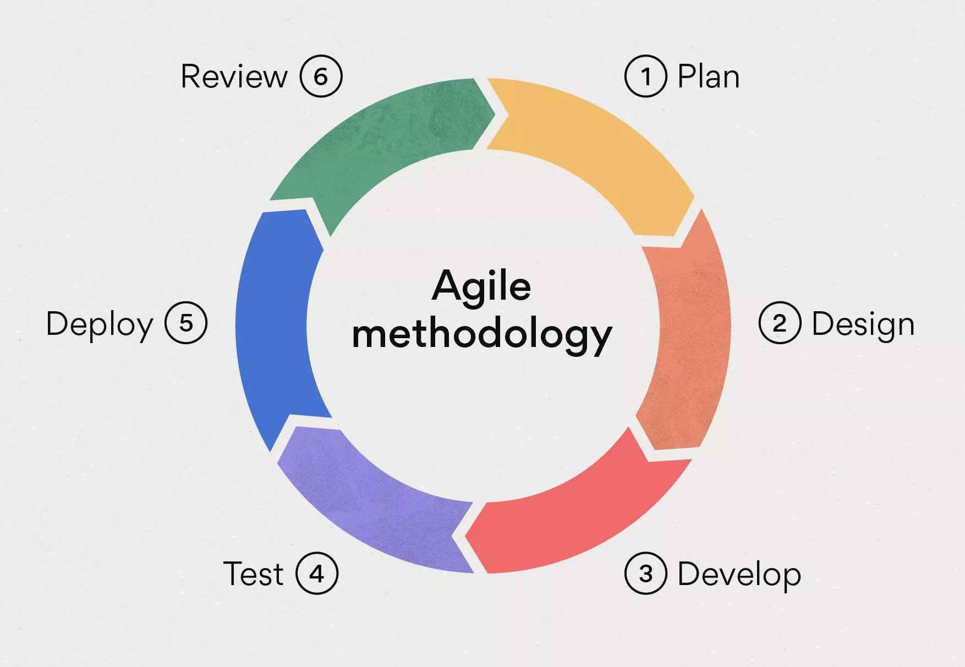
Agile Manifesto
Individuals and interactions over processes and tools.
Working software over comprehensive documentation.
Customer collaboration over contract negotiation.
Responding to change over following a plan.

Slide 3
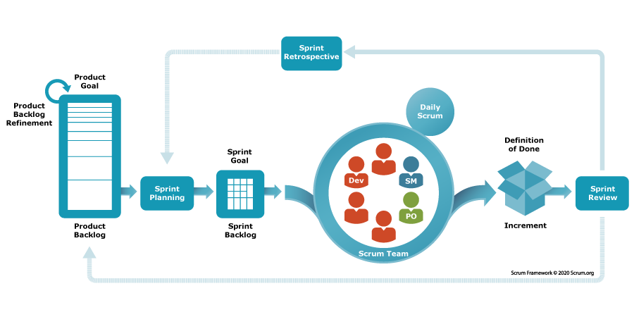
Implementing Agile in E-Commerce
Define user stories
Create cross-functional teams
Prioritize backlog
Iterate in sprints
Review and improve
Notes:
The Bridge Pattern separates the abstraction (e.g., the Shape) from its implementation (e.g., the Color) by creating separate classes for both. This allows changes to either the abstraction or the implementation without affecting the other.Solution: Instead of having combinations like RedCircle, GreenCircle, etc., you have a Shape abstraction with a Color implementation. The Shape class refers to a Color object, but the two can evolve independently.Benefit: You can add new shapes or new colors without modifying existing code, significantly reducing the number of required subclasses.
Instead of using inheritance (where each class inherits from a base class and combines both behavior and state), the Bridge Pattern uses composition (where classes hold references to objects from other classes).

Slide 4
Few User Stories From Ecommerce Appplication
Customer User Stories
As a customer, I need to add products to my shopping cart, so that I can review and purchase them later.
As a customer, I need to authenticate myself, so that I can see my account details and past orders.
As a customer, I want to be able to view product details, including images, descriptions, prices, and customer reviews, so I can make informed purchasing decisions.
As a customer, I need to add products to my shopping cart, so that I can review and purchase them later.
Sales Representative
As a sales representative, I want to help customers modify their orders (e.g., quantity, shipping address), so that I can enhance their experience and meet their needs.
As a sales representative, I want to view all orders, regardless of the customer, so that I can track and manage sales more effectively.
As a sales representative, I want to edit product details, so that I can keep the information up to date.
As a sales representative, I want to add products, so that I can expand the product offerings for customers.
Notes:
The Bridge Pattern separates the abstraction (e.g., the Shape) from its implementation (e.g., the Color) by creating separate classes for both. This allows changes to either the abstraction or the implementation without affecting the other.Solution: Instead of having combinations like RedCircle, GreenCircle, etc., you have a Shape abstraction with a Color implementation. The Shape class refers to a Color object, but the two can evolve independently.Benefit: You can add new shapes or new colors without modifying existing code, significantly reducing the number of required subclasses.
Instead of using inheritance (where each class inherits from a base class and combines both behavior and state), the Bridge Pattern uses composition (where classes hold references to objects from other classes).

Slide 5
Few User Stories From Ecommerce Appplication
Shipment Vendor User Stories
As a shipment vendor, I want to update the shipment status, so that customers and stakeholders can track their deliveries.
As a shipment vendor, I want to view all deliveries scheduled for a specific date, so that I can prioritize and manage shipments efficiently for that day.
As a shipment vendor, I want to log in to the system, so that I can manage my shipments and monitor my performance.
As a shipping vendor, I want to ship and deliver orders to the customer, so that I can complete the fulfilment process for the merchant.
Notes:
The Bridge Pattern separates the abstraction (e.g., the Shape) from its implementation (e.g., the Color) by creating separate classes for both. This allows changes to either the abstraction or the implementation without affecting the other.Solution: Instead of having combinations like RedCircle, GreenCircle, etc., you have a Shape abstraction with a Color implementation. The Shape class refers to a Color object, but the two can evolve independently.Benefit: You can add new shapes or new colors without modifying existing code, significantly reducing the number of required subclasses.
Instead of using inheritance (where each class inherits from a base class and combines both behavior and state), the Bridge Pattern uses composition (where classes hold references to objects from other classes).

Slide 6




THANK YOU
(844) 720-6678
info@simplifyhealthcare.com
simplifyhealthcare.com
Simplify Healthcare
U.S.: 600 N Commons Drive, Suite 110, Aurora, IL 60504
India: 401/402, 4th Floor, Pentagon P-2, Magarpatta City, Pune 411013
CONNECT WITH US
LinkedIn
YouTube
X
Instagram

Slide 7
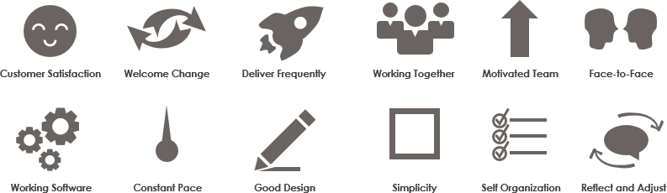
Key Agile Principles

Slide 8
Case Study: Successful Agile E-Commerce Implementation
Agile is a project management and software development approach that aims to be more effective.
It focuses on delivering smaller pieces of work regularly instead of one big launch.
This allows teams to adapt to changes quickly and provide customer value faster.

Slide 9

Why Agile for E-Commerce?
Faster Time to Market
Enhanced Customer Experience
Continuous Improvement
Ability to Adapt to Changing Trends
Optimized Development Cycles
Higher Quality
This Photo by Unknown Author is licensed under CC BY-SA-NC

